Slide 1
An analysis of clay formation processes on Marshall Gulch, Mount Lemmon, Arizona
Joshua Hoskinson
Adviser: Dr. Craig Rasmussen
NASA/UA Arizona Space Grant Consortium
NSF Critical Zone Observatory Project
The University of Arizona

Slide 2
Introduction
Objective: Clay-formation processes in forested catchment (Marshall Gulch).
Importance: Nutrient retention → impacts soil health, primary productivity, surface water chemistry.
Previous work has shown convergent areas have nutrient-rich soil solution (Ca, Mg, K, Na, Si).

Slide 3
Hypothesis based on soil solution chemistry
Areas with HIGH concentration of cations (Ca, Mg, K, Na, Si): Contain silica RICH minerals (Smectite) | Areas with LOW concentration of cations (Ca, Mg, K, Na, Si): Contain silica POOR minerals (Kaolinite, Gibbsite)

Slide 4
Methods
I. Clay Extraction - Organic Matter Removal - Clay Dialysis | II. Analyses - Clay Slides (QXRD) - Powder Mounts (QXRD) - TG/DTA (Thermal Analysis)

Slide 5
Silica-poor clays – Clay slide XRD
M
K
G

Slide 6
Silica-rich clays – Clay Slide XRD
S
K

Slide 7
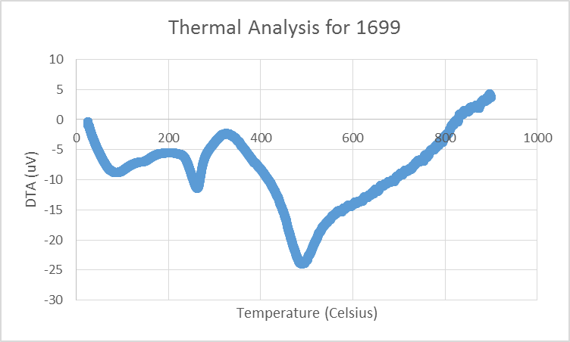
DTA Analysis for Silica-poor sample
V
G
K

Slide 8
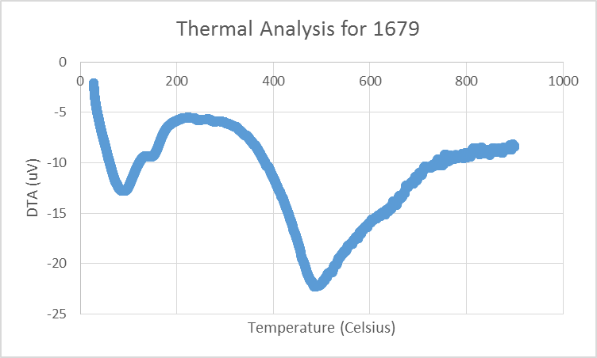
DTA Analysis for Silica-rich sample
S
K

Slide 9
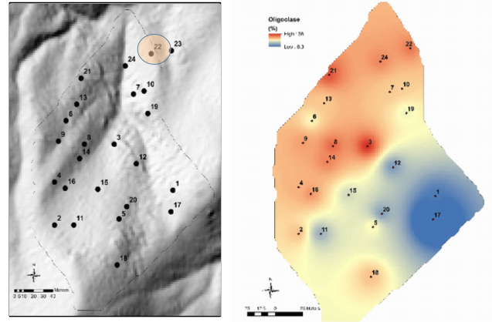

Slide 10
Conclusions
The clay minerals found in the various locations in Marshall Gulch, Mt. Lemmon, Arizona were not primarily formed as a result of the soil solution chemistry, but rather the parent material! (oligoclase).

